Slide 1

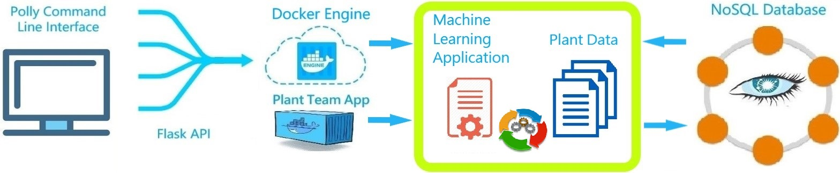
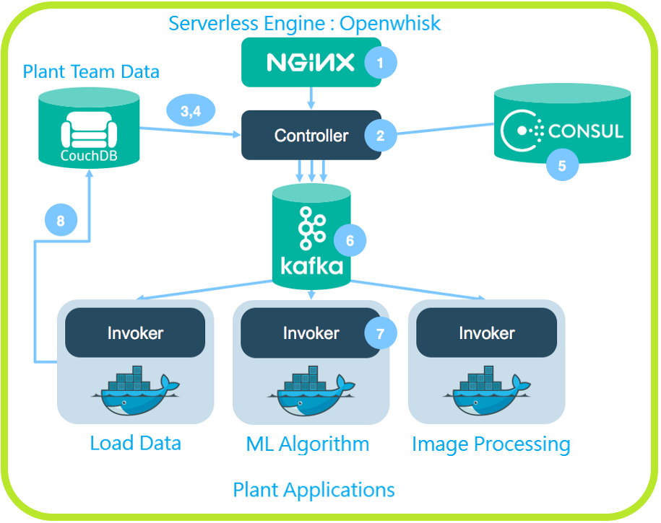
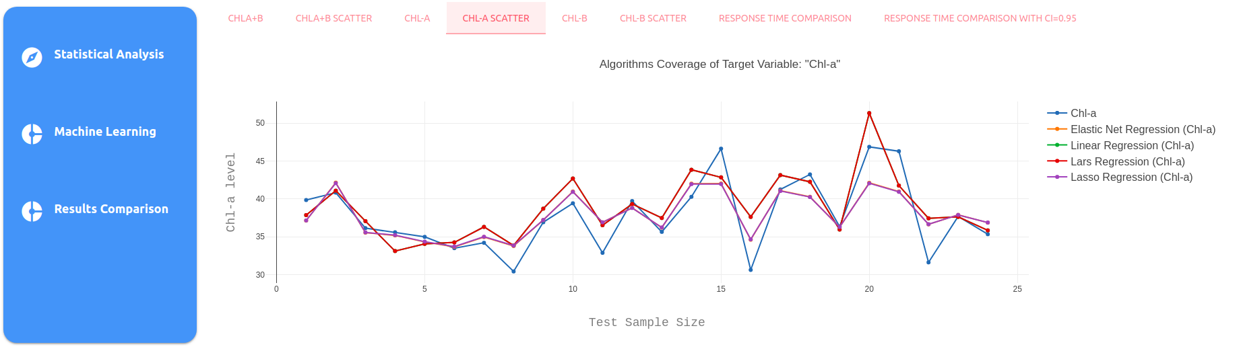
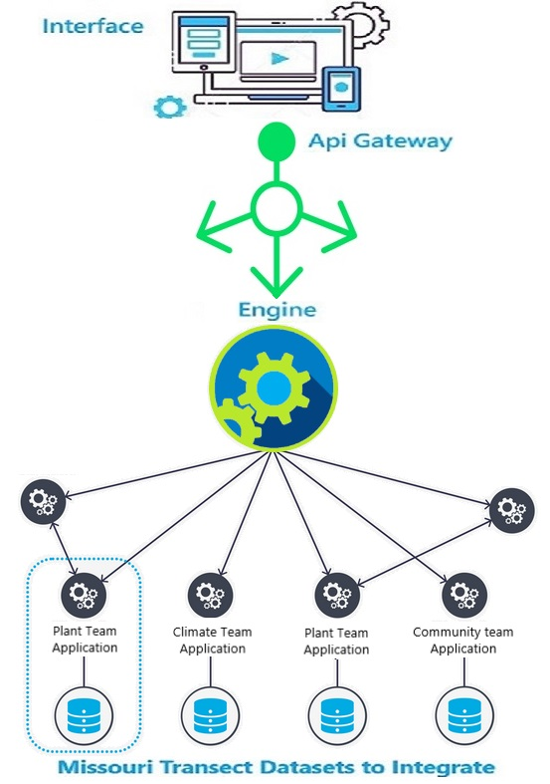
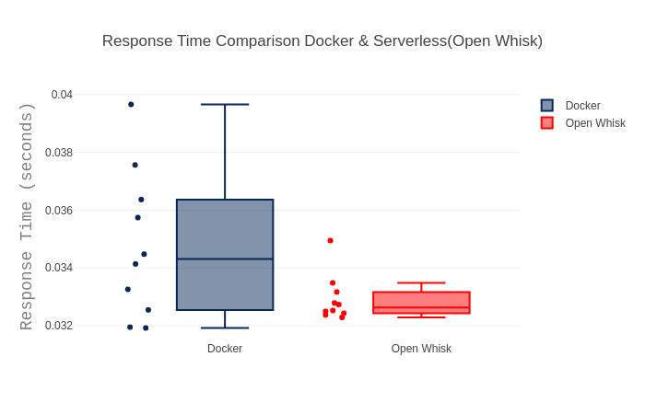
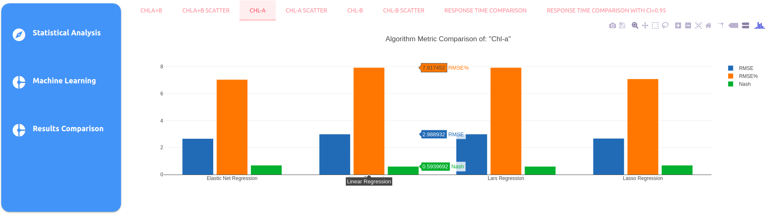
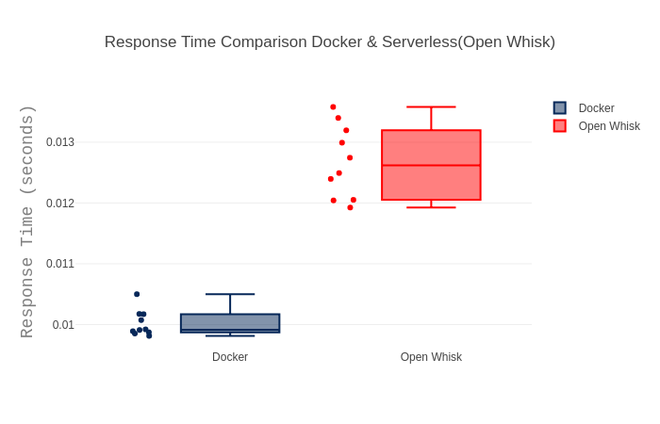
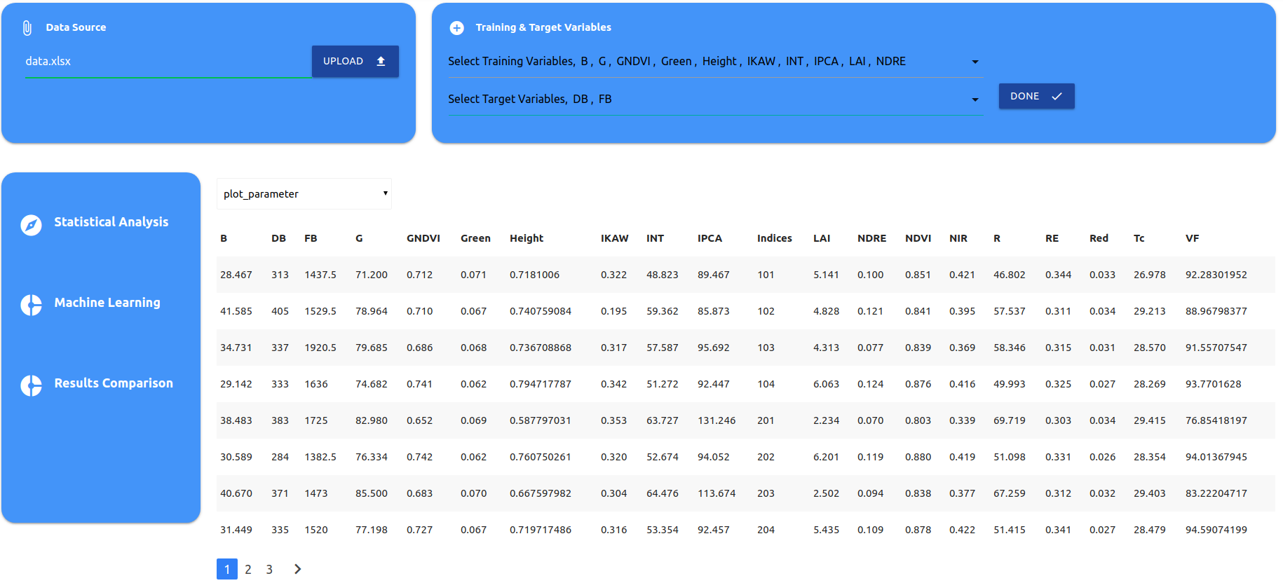
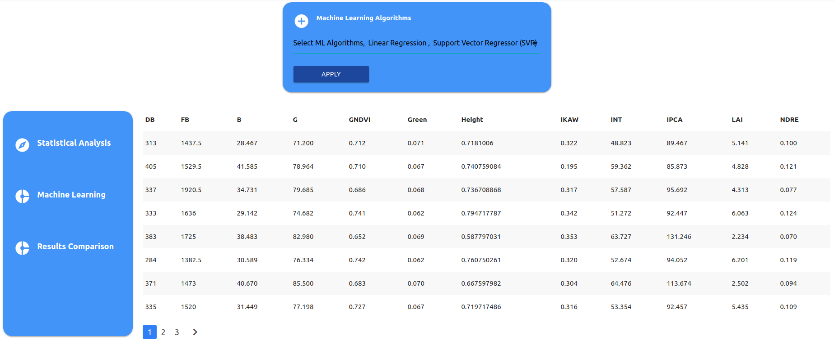
Polly: A Tool for EPSCoR Big Data Integration
Student Authors: Waqar Muhammad * and Alessio Scalingi *
Advisors: Flavio Esposito * and Vasit Sagan §
*Computer Science Department §Department of Earth & Atmospheric Sciences
Saint Louis University, USA
Abstract
Workflow & Container-Based Technology
Openwhisk Architecture
Datasets are often isolated, noisy, and with different formats; the Missouri Transect dataset collection is no exception. However, understanding climate change impacts on agriculture, e.g., predicting yield in various stress scenarios, requires integration of multiple dataset including remote sensing images, crop physiology data, and climate data. Unexperienced users mostly rely on proprietary Cloud platforms and data analysis tools such as Rapid-Miner, Weka or SPSS, which have limited functionalities and scale poorly.
To this aim, we present Polly, a system designed with current technologies that allows data integration, processing and analytics in support of the research and teaching activities within the EPSCoR project.
In particular, our system is designed to scale and it is composed by a Serverless [2] architecture, a Cassandra NoSQL database, and with our API users may access a set of machine learning tools such as linear and support vector regression. We are testing Polly on a set of EPSCoR Plant Team datasets to answer a few representative data science questions. For example, we showed how to use Polly to run several regression models with the aim of estimating different biochemical and biophysical features (e.g., chlorophyll, nitrogen on leaves) [1].
Results produced by Polly: Comparison of Regression Models for Leaf Chlorophyll (Chl-A) Prediction
Prototype Architecture
Serverless vs Container
Tradeoff Performance Results
References
Multiple machine learning algorithms are applied on a “Plant team” ground truth dataset to show the regression analysis functionality of our tool Polly. The Grouped Bar graph (bottom) compares the performance of several algorithms using different metrics: Nash coefficient, Root Mean Squared Error (RMSE) and Relative RMSE. Scatter Plot (top) shows which regression model fits best to out target variable (CHL-a).
[1] Maimaitijiang, Maitiniyazi, et al. "Unmanned Aerial System (UAS)-based phenotyping of soybean using multi-sensor data fusion and extreme learning machine." ISPRS Journal of Photogrammetry and Remote Sensing 134 (2017): 43-58.
[2] Hendrickson, S., et al. "Serverless computation with OpenLambda." Elastic 60 (2016): 80.
[3] Singh, Sachchidanand, and Nirmala Singh. "Containers & Docker: Emerging roles & future of Cloud technology." Applied and Theoretical Computing and Communication Technology (iCATccT), 2016 2nd International Conference on. IEEE, 2016.
Polly Web Interface
Surprisingly, Serverless computing [2] does not always provide better response time than Container technology [3]. Performance vary according to the dataset size.
User can interact with our work-in-progress system via a simple web interface: users can upload datasets and specify both training and target variables; users can then choose how many and which (Machine Learning) algorithms to run on their dataset. After the computations is complete, different graphs are generated to explore and evaluate results on different models as we showed in the “Chl-A results”.
* Muhammad & Scalingi contributed equally to this project.

